Slide 1
EDA Exploratory Data Analysis

Slide 2
EDA
Exploratory data analysis (EDA) is used by data scientists to analyze and investigate data sets and summarize their main characteristics, often employing data visualization methods. It helps determine how best to manipulate data sources to get the answers you need, making it easier for data scientists to discover patterns, spot anomalies, test a hypothesis, or check assumptions.

Slide 3
Types of EDA
1. Univariate Analysis: This sort of evaluation makes a specialty of analyzing character variables inside the records set. It involves summarizing and visualizing a unmarried variable at a time to understand its distribution, relevant tendency, unfold, and different applicable records. Techniques like histograms, field plots, bar charts, and precise information are generally used in univariate analysis.
2. Bivariate Analysis: Bivariate evaluation involves exploring the connection between variables. It enables find associations, correlations, and dependencies between pairs of variables. Scatter plots, line plots, correlation matrices, and move-tabulation are generally used strategies in bivariate analysis.
3. Multivariate Analysis: Multivariate analysis extends bivariate evaluation to encompass greater than variables. It ambitions to apprehend the complex interactions and dependencies among more than one variables in a records set. Techniques inclusive of heatmaps, parallel coordinates, aspect analysis, and primary component analysis (PCA) are used for multivariate analysis.

Slide 4
Measures in Exploratory Data Analysis (EDA)
Visualizing data
Initial Data Analysis (IDA)
Data Preparation
Missing Value Treatment
Outlier Detection
Feature Scaling
Feature Engineering
Categorical encoding
Feature Splitting
Feature Transformation
Dimensionality Reduction Techniques

Slide 5
Anomaly Detection
Identification of rare items, events or observations which raise suspicions by differing
significantly from the majority of the data
Anomalies are also referred to as outliers, novelties, noise, deviations and exceptions.
Anomaly detection is applicable in a variety of domains:
Intrusion detection
Fraud detection
Fault detection
System health monitoring
Event detection in sensor networks
Detecting ecosystem disturbances.
It is often used in preprocessing to remove anomalous data from the dataset

Slide 6
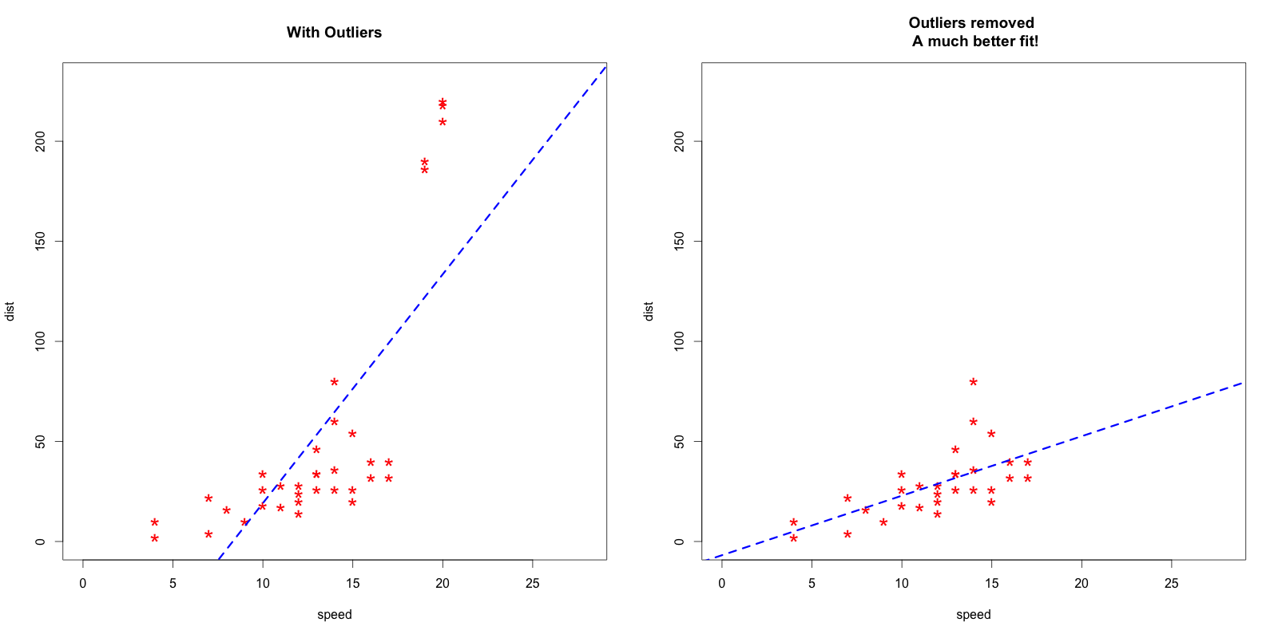

Slide 7
Outlier Detection
“Observation which deviates so much from other observations as to arouse suspicion it was generated by a different mechanism”
Outliers are extreme values that deviate from other observations on data , they may indicate a variability in a measurement, experimental errors or a novelty.
Outlier is an observation that diverges from an overall pattern on a sample.
Outliers can be of two kinds: univariate and multivariate.
Univariate outliers can be found when looking at a distribution of values in a single feature space.
A univariate outlier is a data point that consists of an extreme value on one variable.
Multivariate outliers can be found in a n-dimensional space (of n-features).
A multivariate outlier is a combination of unusual scores on at least two variables.
There are parametric methods and non-parametric methods that are employed to identify outliers.
Parametric methods involve assumption of some underlying distribution such as normal distribution
There is no such requirement with non-parametric approach.

Slide 8
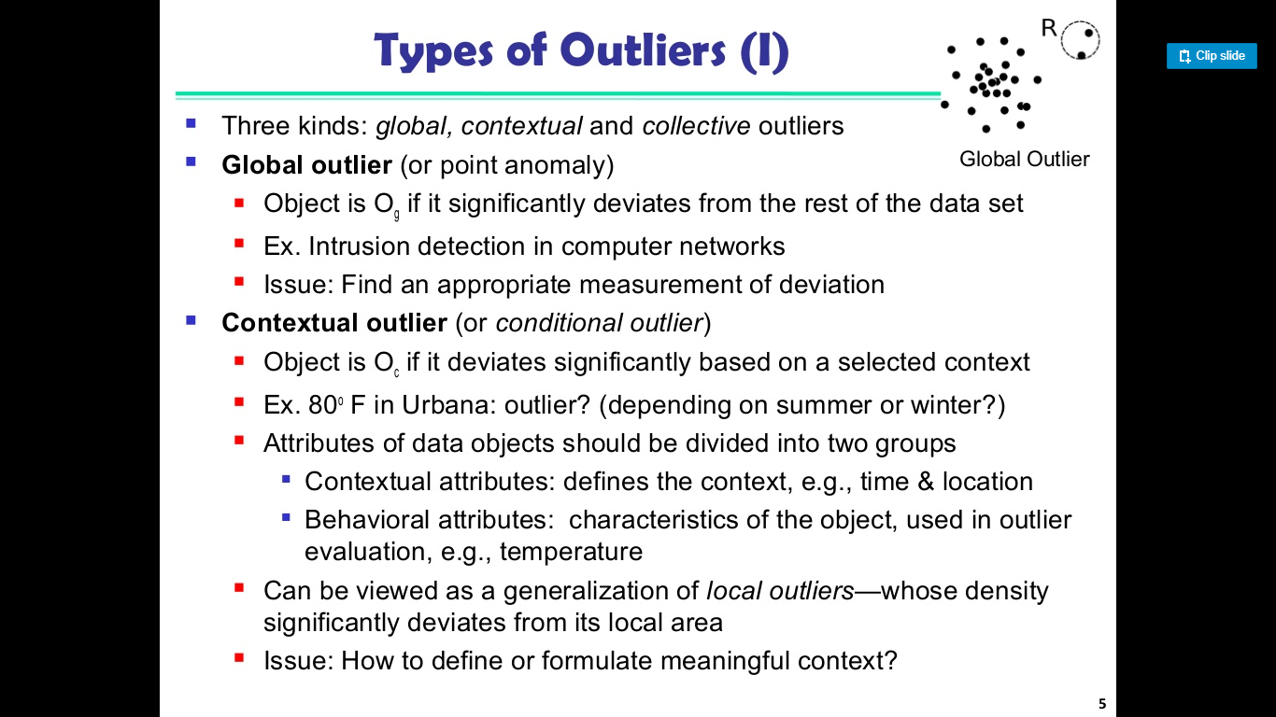

Slide 9
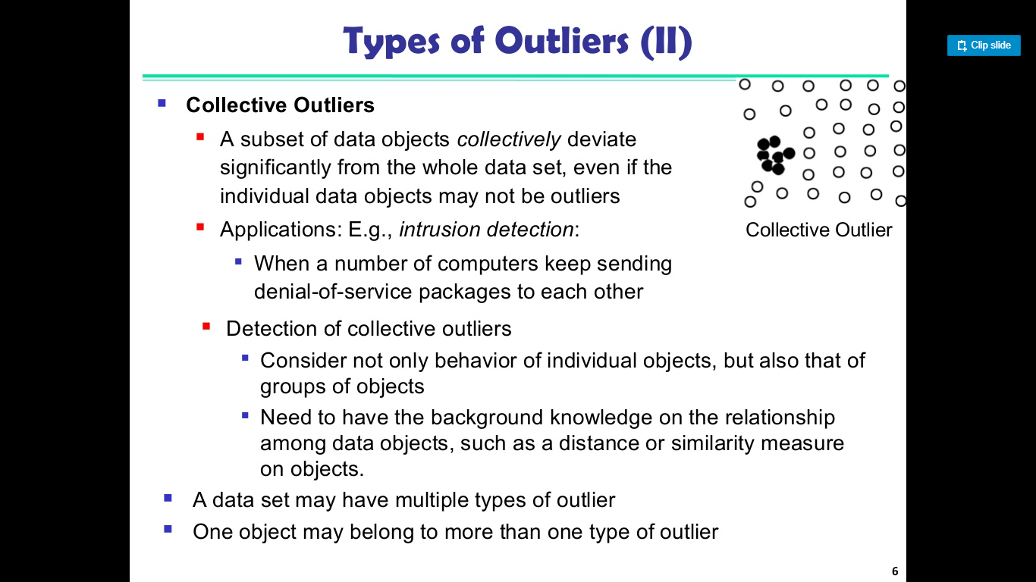

Slide 10
Most common causes of outliers on a data set:
Data entry errors (human errors)
Measurement errors (instrument errors)
Experimental errors (data extraction or experiment planning/executing errors)
Intentional (dummy outliers made to test detection methods)
Data processing errors (data manipulation or data set unintended mutations)
Sampling errors (extracting or mixing data from wrong or various sources)
Natural (not an error, novelties in data)

Slide 11
Popular methods for outlier detection are:
Z-Score or Extreme Value Analysis (parametric)
Probabilistic and Statistical Modeling (parametric)
Box Plot method
Nonparametric
DBSCAN(Density Based Spatial Clustering of Applications with Noise)
Isolation Forest

Slide 12
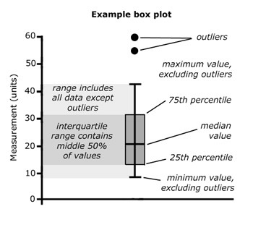
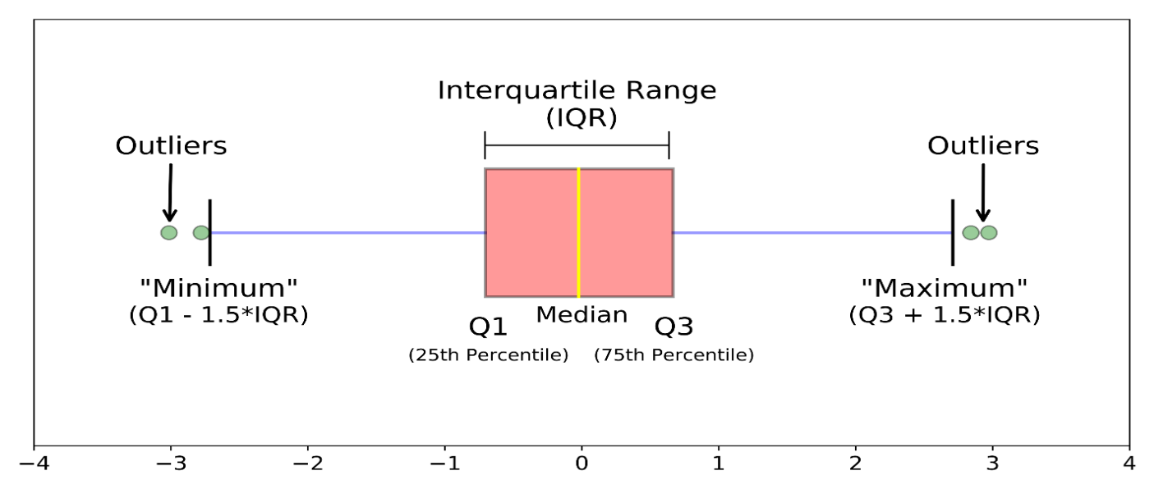
Box Plot
A univariate outlier is a data point that consists of an extreme value on one variable
The Box Plot Rule
For a given continuous variable, outliers are those observations that lie outside 1.5 * IQR, where IQR, the ‘Inter Quartile Range’ is the difference between 75th and 25th quartiles.
This is also known as “The Box Plot Rule”.
Look at the points outside the whiskers in a box plot.

Slide 13
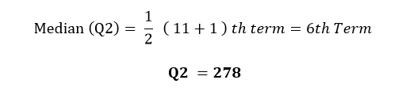
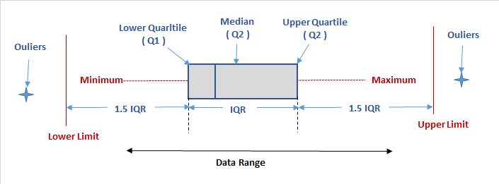
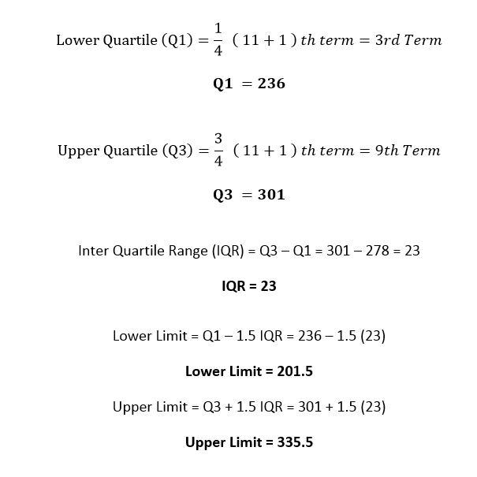
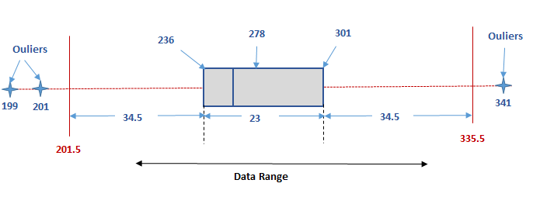
Data →199, 201, 236, 269,271,278,283,291, 301, 303, 341
N=11
Hence it is clear that any range above 333.5 or below 201.5 are outliers. Hence in the data series 199, 201, 236, 269,271,278,283,291, 301, 303, 341, outliers are 199, 201 and 341. These 3 values which lies on either of the extremes can be considered abnormal

Slide 14
Summary Box Plot
A box and whisker plot—also called a box plot—displays the five-number summary of a set of data.
The five-number summary is the minimum, first quartile, median, third quartile, and maximum.
Step 1 : Order the data
Step 2: Find the median
Step 3: Find the quartiles Q1, Q3
Step 4: Complete the five number summary min,max
Step 5: Scale and label an axis that fits the five-number summary
Step 6: Draw a box from Q1 to Q3 with a vertical line through the median.
Step 7: Draw a whisker from Q1 to the min and from Q3 to the max.
IQR →The "interquartile range", abbreviated "IQR", is just the width of the box in the box-and-whisker plot. That is, IQR = Q₃ – Q₁ . The IQR can be used as a measure of how spread-out the values are.
Outlier →A outlier is any value that lies more than one and a half times the length of the box from either end of the box.

Slide 15
Find outliers in the dataset
Find the outliers, if any, for the following data set:
10.2, 14.1, 14.4. 14.4, 14.4, 14.5, 14.5, 14.6, 14.7, 14.7, 14.7, 14.9, 15.1, 15.9, 16.4

Slide 16
10.2, 15.9, and 16.4

Slide 17


Z score Method
Z-score technique assumes a Gaussian distribution of the data. The outliers are the data points that are in the tails of the distribution and therefore far from the mean.
How far depends on a set threshold z_{thr} for the normalized data points z_{i} calculated with the formula:
Though Z-Score is a highly efficient way of detecting and removing outliers, we cannot use it with every data type. When we said that, we mean that it only works with the data which is completely or close to normally distributed, which in turn stimulates that this method is not for skewed data, either left skew or right skew. For the other data, we have something known as Inter quartile range (IQR) method
An outlier is then a normalized data point which has an absolute value greater than z_{thr}.
where x_{i} is a data point, μ is the mean of all x_{i} and is the standard deviation of all x_{i}.

Slide 18
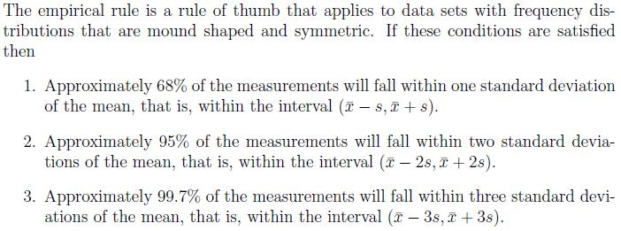
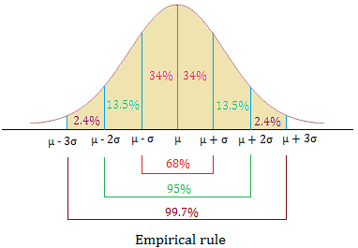
Empirical Rule

Slide 19
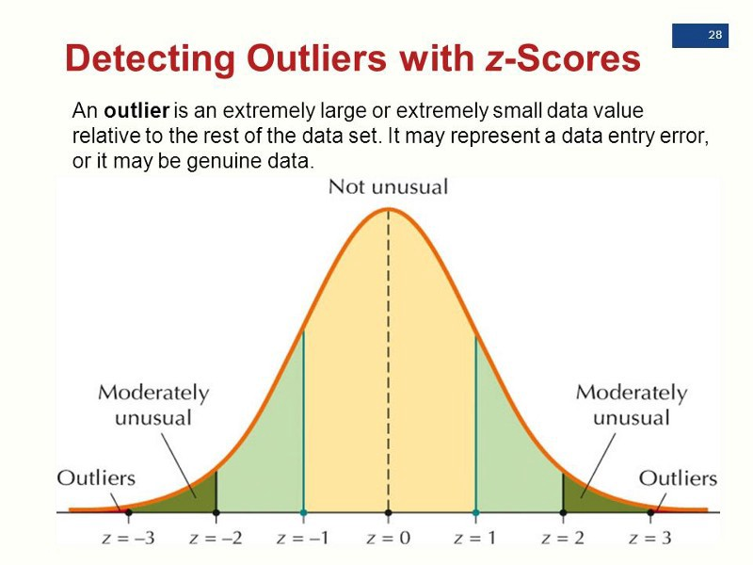

Slide 20
Outlier Tests
DBSCAN
Isolation Forest

Slide 21
Missing Value
Missing data are observations that we intend to make but couldn’t.
Missing data can occur for many reasons:
participants can fail to respond to questions (legitimately or illegitimately—more on that later),
equipment and data collecting or recording mechanisms can malfunction,
subjects can withdraw from studies before they are completed, and
data entry errors can occur.
When we have missing data, our goal remains the same with what it was if have the complete data. So, the analysis are now more complex.

Slide 22



Missing data
Missing data is a common problem and challenge for analysts.
There are many reasons why data could be missing, including:
Respondents forgot to answer questions.
Respondents refused to answer certain questions.
Respondents failed to complete the survey.
A sensor failed.
Someone purposefully turned off recording equipment.
There was a power cut.
The method of data capture was changed.
An internet connection was lost.
A network went down.
A hard drive became corrupt.
A data transfer was cut short.

Slide 23
Missing data
Missing Completely at Random (MCAR)
Missing at Random (MAR)
Not Missing at Random (NMAR)
Notes:
Another example:
MCAR: Survey questions asked only to a random sample of original sample.
MAR: Respondents in service occupations less likely to report income.
NMAR: Respondents with high income less likely to report income.
NMAR is difficult to analyse / complex

Slide 24
Missing completely at Random
Missing values are not dependent or related to any feature of data.
Example some row of data is missing due to while copying the data.

Slide 25
Missing at Random
Missing data are missing at random (MAR) when the probability of missing data on a variable is related to some other measured variable in the model, but not to the value of the variable with missing values itself.
For example, only younger people have missing values for IQ.
In that case the probability of missing data on IQ is related to age.

Slide 26
Missing Not at Random
Data are missing not at random (MNAR) when the missing values on a variable are related to the values of that variable itself, even after controlling for other variables.
For example, when data are missing on IQ and only the people with low IQ values have missing observations for this variable.

Slide 27
Missing data
Another example: Survey data on drug use.
Missing Completely at Random (MCAR):
You removed 10% of the respondents data randomly.
Missing at Random (MAR):
People who come from poorer families might be less inclined to answer questions about drug use, and so the level of drug use is related to family income.
Not Missing at Random (NMAR):
Students skipped the question on drug use because they feared that they would be expelled from school.

Slide 28
Procedure for dealing with missing data
Generally the procedure for dealing with missing data is:
Identify the missing data.
Identify the cause of the missing data.
Either:
Remove the rows containing the missing data
Also called the naïve approach.
Make sure missing data isn’t biased!
Replace missing values with alternative values.
Impute the missing values.
There are a number of approaches.
Deciding between A and B depends on which outcome you think will produce the most reliable and accurate results.

Slide 29
Missing data methods
Deletion Methods
Listwise deletion
Pairwise deletion
Imputation Methods
Single Imputation
Multiple Imputation

Slide 30
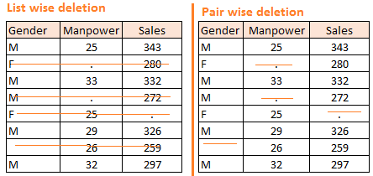
Listwise Deletion
With listwise deletion, or complete case analysis, all cases with missing scores on one or more variables are excluded from the analysis.
The advantage of this method is that the remaining dataset is complete.
However, this complete dataset has a reduced sample size and power, caused by the loss of the incomplete cases.
Also the chance of having a biased dataset is substantial if data is not MCAR.
In most situations, the disadvantages of listwise deletion far outweigh its advantages

Slide 31
Pairwise deletion
In pairwise deletion, or available case analysis, incomplete cases are deleted on an analysis-by-analysis basis.
Consequently, any given case may contribute to some analyses but not to others.
In this approach the sample size will remain the same for some analyses and will be reduced for others.
The main problem in this method is the assumption of the MCAR mechanism to produce unbiased estimates , but also the inconsistency of the sample size can lead to problems in computing standard errors.

Slide 32
Removing Missing data rows
 | Listwise deletion (complete case analysis) | Pairwise deletion
Description: | Analyse the data rows where there is complete data for every column. | Analyse the data rows where the variables of interest have data present.
Advantages: | Simple Easily compare across analyses. | Uses all possible information.
Limitations: | Could be biased (if the data is not MCAR). Lower n, reduces statistical power. | Separate analyses cannot be compared as the data / sample will be different.
Notes:
Draw 2 types of tables for example?

Slide 33
Imputation Methods
Single Imputation
Mean Imputation
Regression Imputation
Matching Methods
Last Observation Carried Forward
Multiple Imputation

Slide 34
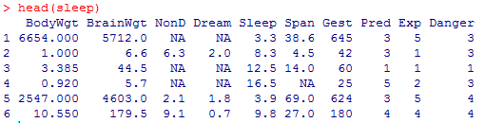
Simple Imputation
Simply replace the missing values with the mean, median or mode:
mean(x)
median(x)
mode
Mean
8.672917
(Mean of NonD)
19.87759
(Mean of Span)

Slide 35
Mean imputation
Mean imputation is a method in which the missing value on a certain variable is replaced by the mean of the available cases.
This method maintains the sample size and is easy to use, but the variability in the data is reduced, so the standard deviations and the variance estimates tend to be underestimated.
The magnitude of the covariances and correlation also decreases by restricting the variability and this method often causes biased estimates, irrespective of the underlying missing data mechanism.
Conditional Mean

Slide 36
Regression imputation
In single regression imputation the imputed value is predicted from a regression equation.
For this method the information in the complete observations is used to predict the values of the missing observations.
Regression assumes that the imputed values fall directly on a regression line with a nonzero slope, so it implies a correlation of 1 between the predictors and the missing outcome variable.
Opposing the mean substitution method, regression imputation will overestimate the correlations, however, the variances and covariances are underestimated.

Slide 37
Matching methods
Hot-deck imputation is a technique where non-respondents are matched to resembling respondents and the missing value is imputed with the score of that similar respondent .
Two hot-deck approaches are the
Distance function approach
Pattern matching approach.
The distance function approach, or nearest neighbor approach, imputes the missing value with the score of the case with the smallest squared distance statistic to the case with the missing value.
The matching pattern method is more common, where the sample is stratified in separate homogenous groups. The imputed value for the missing case is randomly drawn from cases in the same group .

Slide 38
Last observation carried forward
The last value carried forward method is specific to longitudinal designs.
This technique imputes the missing value with the last observation of the individual.
This method makes the assumption that the observation of the individual has not changed at all since the last measured observation, which is mostly unrealistic .

Slide 39

Multiple Imputation
The idea of Multiple Imputation is to replace each missing value with multiple acceptable values that represent a distribution of possibilities.
This results in a number of complete datasets (usually 3-10):
Analyse
Impute
Pool
Dataset with missing values
Dataset with multiple imputation applied
Imputed datasets
Analysis results of datasets

Slide 40
Multiple imputation
In multiple imputation, the imputation process is repeated multiple times resulting in multiple imputed datasets.
In this method the imputation uncertainty is accounted for by creating these multiple datasets.
The multiple imputation process contains three phases:
The imputation phase,
The analysis phase
The pooling phase
Multiple imputation works well when missing data are MAR
In the imputation model, the variables that are related to missingness, can be included.
That way bias is reduced and estimates are more precise.

Slide 41
Imputation phase
In the first phase, the imputation phase, several copies of the data set are created each containing different imputed values.
The imputed values are estimated using the means and covariance of the observed data.
Regression equations are used to predict the incomplete values from the complete values and a normally distributed residual term is added to each value to restore variability.
Analysis phase
In the second phase, the analysis phase, the statistical analysis is carried out.
On each imputed dataset, the analysis is carried out that would have been applied had the data been complete.
That way as many sets of results are created as the number of imputed datasets created in the imputation phase.
Pooling phase
Finally, in the pooling phase, the multiple sets of results or parameter estimates are combined into a single set of results.

Slide 42
Multiple Imputation
The general procedure for the chained equation approach to multiple imputation
A simple imputation is performed for every missing value.
One of the missing variables are set back to missing.
Regression is performed (linear, logistic, polynomial etc.), the missing variable being the forecast variable and all other variables in the dataset being the predictor variables.
Missing values are replaced with predictions (imputations) from the regression.
Repeat steps 2-4 for each variable that has missing data (one cycle).
Repeat for a number of cycles then retain results as one imputed dataset.

Slide 43
Replacing Missing data
The two most common methods for replacing missing data are:
 | Simple Imputation | Multiple Imputation
Description: | Missing values are replaced with the mean, median or mode value. | Estimates missing data through repeated simulations.
Stochastic: | No | Yes
Advantages: | Simple. | Variability more accurate.
Limitations: | Could be biased (if the data is not MCAR). Underestimates standard errors. Could distort correlations among variables. | Algorithms are more complex. Normally would require complex coding .

Slide 44
Methods in Python to fill missing value
pd.isna()
pd.notna()
pd.isnull()
pd.notnull()
pd.dropna()
pd.fillna()
pd.bfill()
pd.backfill()
pd.ffill()
pd.pad()
pd.interpolate()
pd.replace()

Slide 45
Feature Scaling Methods
Normalization
Standardization

Slide 46
Normalization of values
Normalization is a scaling technique in Machine Learning applied during data preparation to change the values of numeric columns in the dataset to use a common scale. It is not necessary for all datasets in a model. It is required only when features of machine learning models have different ranges.

Slide 47
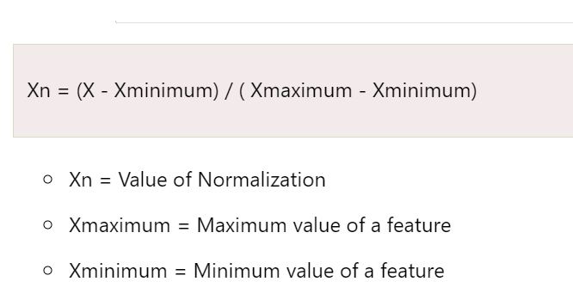
MIN MAX
Let's assume we have a model dataset having maximum and minimum values of feature as mentioned above. To normalize the machine learning model, values are shifted and rescaled so their range can vary between 0 and 1. This technique is also known as Min-Max scaling. In this scaling technique, we will change the feature values as follows:
Further, it is also useful for data having variable scaling techniques such as KNN, artificial neural networks.

Slide 48
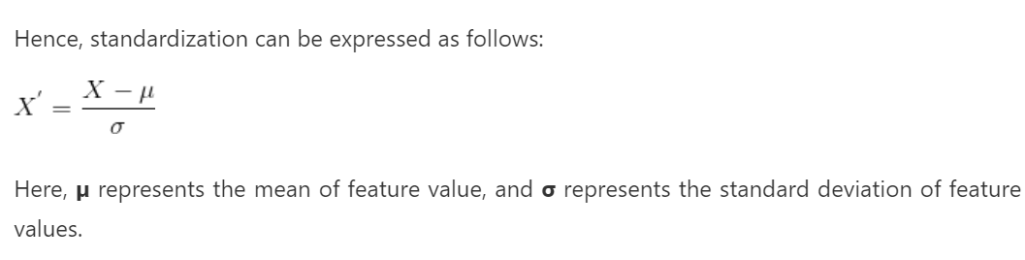
Standardization
Standardization scaling is also known as Z-score normalization, in which values are centered around the mean with a unit standard deviation, which means the attribute becomes zero and the resultant distribution has a unit standard deviation. Mathematically, we can calculate the standardization by subtracting the feature value from the mean and dividing it by standard deviation.
Further, it is also useful when data has variable dimensions and techniques such as linear regression, logistic regression, and linear discriminant analysis.

Slide 49
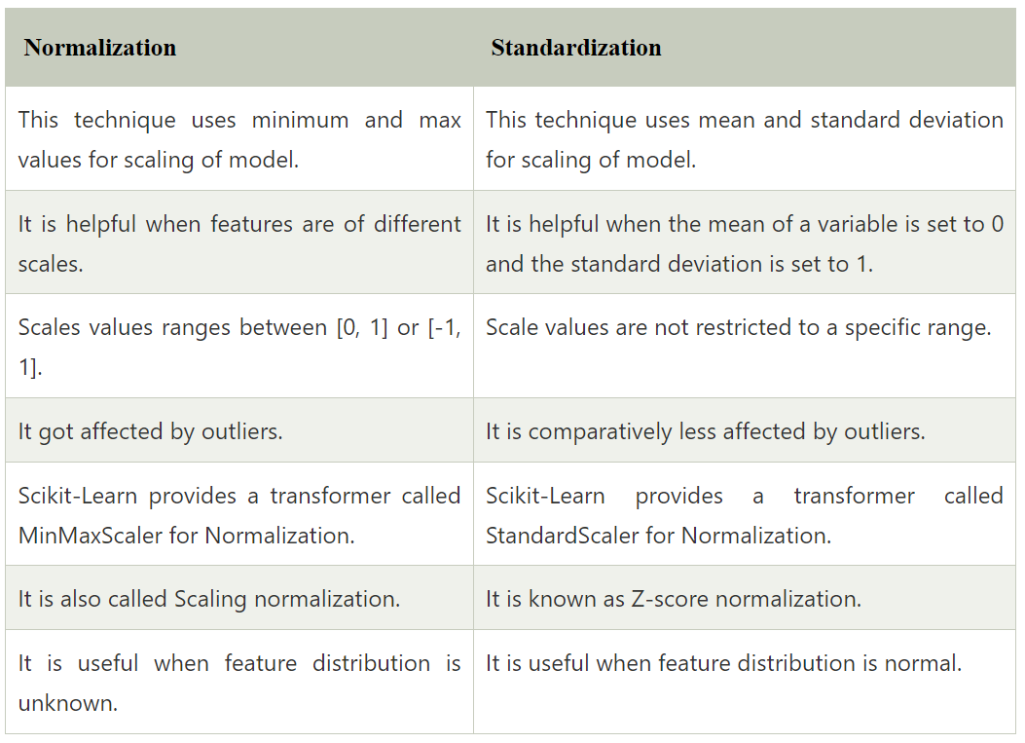

Slide 50
Standard Scalers Python
MinMaxScaler
StandardScaler
MaxAbsScaler
RobustScaler
QuantileTransformer
PowerTransformer
FunctionTransformer

Slide 51
Feature Engineering
1.Feature engineering in Machine Learning involves extracting useful features from given input data following the target to be learned and the machine learning model used. It involves transforming data to forms that better relate to the underlying target to be learned.
2.Features are transformed to a representation which is easily understood by machine learning algorithms.

Slide 52
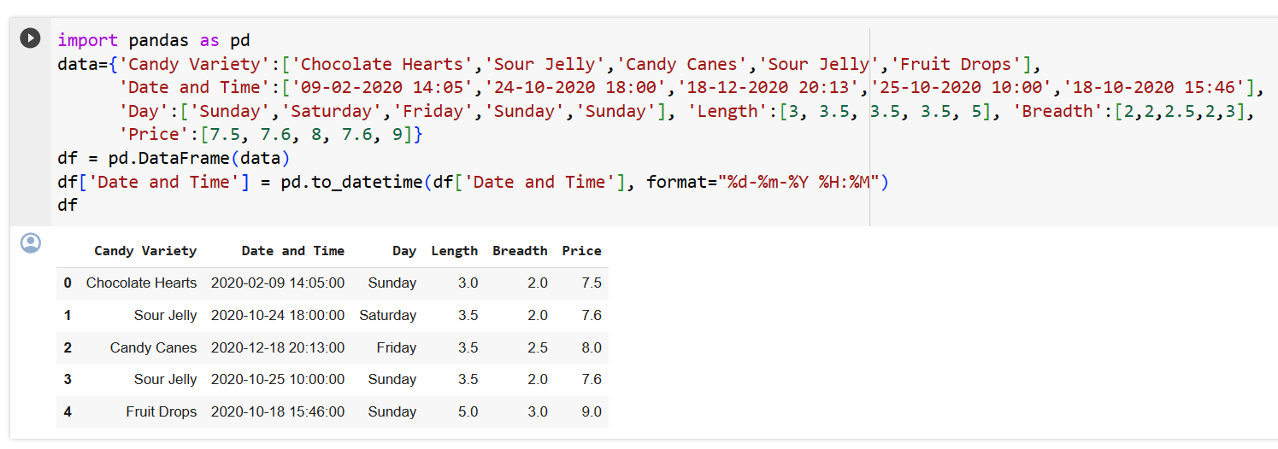
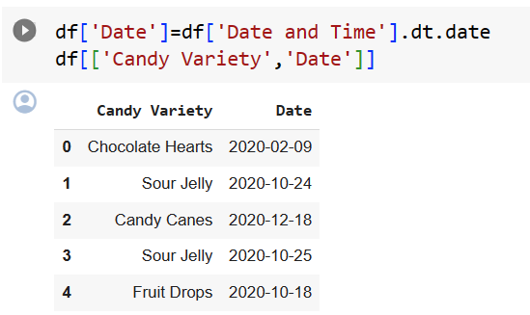
1.Transforming feature

Slide 53
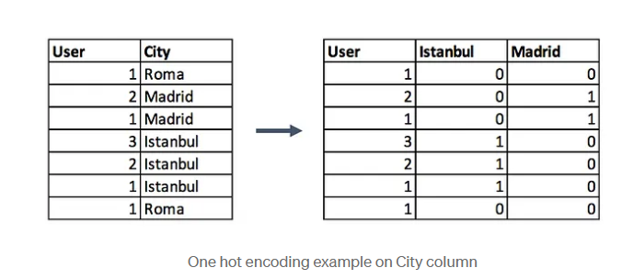
2. Categorical Encoding One hot Encoding
This method changes your categorical data, which is challenging to understand for algorithms, to a numerical format and enables you to group your categorical data without losing any information.
Syntax:
encoded_columns = pd.get_dummies(data['column'])
data = data.join(encoded_columns).drop('column', axis=1)

Slide 54
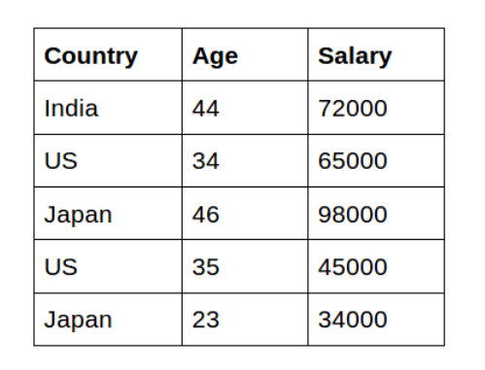
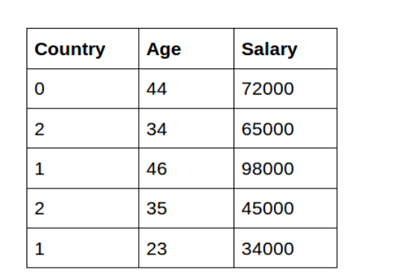
Label Encoding
Provide integer numbers to different categories
Syntax:
from sklearn.preprocessing import LabelEncoder
label_encoder = LabelEncoder()
data['Country']= label_encoder.fit_transform(data[‘Country'])

Slide 55
3.Feature splitting
data.name
0 Luther N. Gonzalez
1 Charles M. Young
2 Terry Lawson
3 Kristen White
4 Thomas Logsdon
#Extracting first names
data.name.str.split(" ").map(lambda x: x[0])
0 Luther
1 Charles
2 Terry
3 Kristen
4 Thomas
#Extracting last names
data.name.str.split(" ").map(lambda x: x[-1])
0 Gonzalez
1 Young
2 Lawson
3 White
4 Logsdon

Slide 56
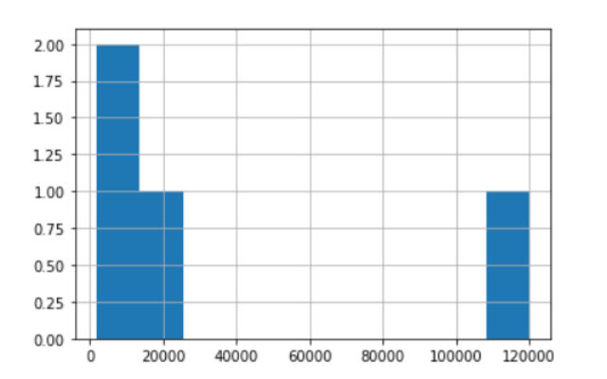
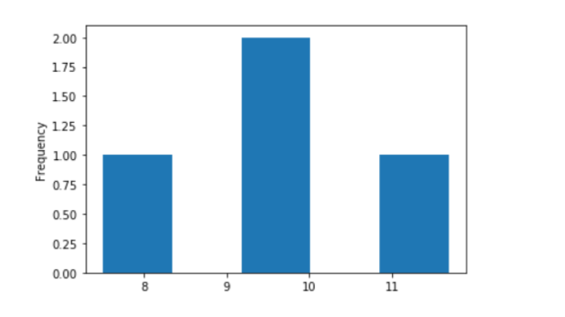
4.Log transformation
The Log Transform is one of the most popular Transformation techniques out there. It is primarily used to convert a skewed distribution to a normal distribution/less-skewed distribution. In this transform, we take the log of the values in a column and use these values as the column instead.
Before log transform After log transform
Syntax:
df['log_income'] = np.log(df['Income'])

Slide 57
5.Creating new feature
Taking existing features and combine one or more to get a new feature that is relatively more connected to predictor variable.

Slide 58
Dimensionality Reduction
There are two components of dimensionality reduction:
Feature selection: In this, we try to find a subset of the original set of variables, or features, to get a smaller subset which can be used to model the problem.
Feature extraction: This reduces the data in a high dimensional space to a lower dimension space, i.e. a space with lesser no. of dimensions.

Slide 59
Feature Selection
Univariate Analysis using SelectKBest
Recursive Feature Engineering using RFE
Feature Importance using ExtraTreesClassifier

Slide 60
Dimensionality Reduction Techniques
The various methods used for dimensionality reduction include:
Principal Component Analysis (PCA)
Linear Discriminant Analysis (LDA)

Slide 61
Pros and Cons
Advantages of Dimensionality Reduction
It helps in data compression, and hence reduced storage space.
It reduces computation time.
It also helps remove redundant features, if any.
Disadvantages of Dimensionality Reduction
It may lead to some amount of data loss.
PCA tends to find linear correlations between variables, which is sometimes undesirable.
PCA fails in cases where mean and covariance are not enough to define datasets.
We may not know how many principal components to keep- in practice, some thumb rules are applied.

Slide 62
Feature Engineering PCA
Principal Component Analysis (PCA) is a statistical procedure that uses a technique to convert a set of correlated variables to a set of uncorrelated variables.
PCA basically gives direct access to the correlational structure of the data.

Slide 63
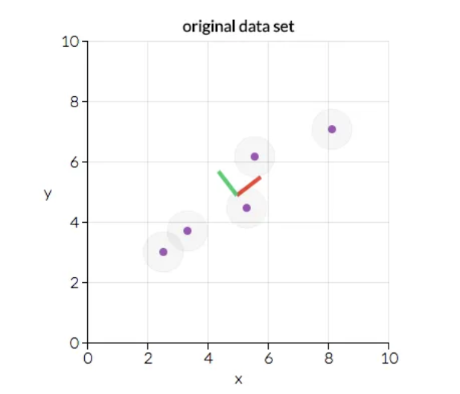
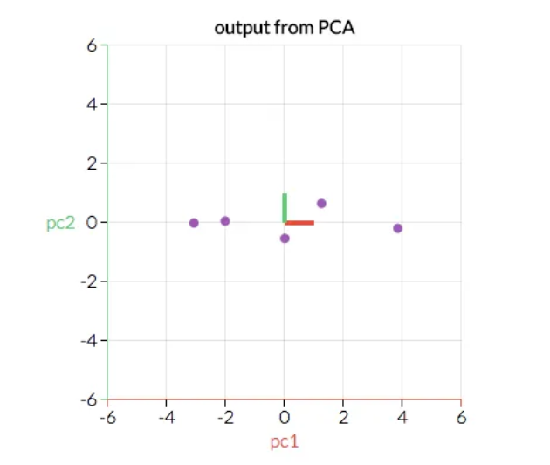
Working of PCA

Slide 64
PCA
Dimensionality reduction: When the features are highly redundant (multicollinear, specifically), PCA will partition out the redundancy into one or more near-zero variance components, which you can then drop since they will contain little or no information.
Anomaly detection: Unusual variation, which is inconsistent with the original features, will often appear in the low-variance components. These components could be highly informative in an anomaly or outlier detection task.
Noise reduction: A collection of sensor readings will always have common background noise. PCA can sometimes collect the (informative) signal into a smaller number of features while leaving the noise alone, thus boosting the signal-to-noise ratio.
Decorrelation: Some ML algorithms struggle with highly-correlated features. PCA transforms correlated features into uncorrelated components, which could be easier for the algorithm to work with.

Slide 65
PCA
Some things need to be kept in mind when working with PCA
PCA only works with numeric features,
PCA is sensitive to scale. It’s good practice to standardize the data before applying PCA,
It is better to remove or constrain outliers since they can create a bias in the results.

Slide 66
Curse of Dimensionality,
“As the number of features or dimensions grows, the amount of data we need to generalize accurately grows exponentially.”

Slide 67
LDA
Linear Discriminant Analysis (LDA) is a supervised learning algorithm used for classification tasks in machine learning. It is a technique used to find a linear combination of features that best separates the classes in a dataset.
LDA works by projecting the data onto a lower-dimensional space that maximizes the separation between the classes. It does this by finding a set of linear discriminants that maximize the ratio of between-class variance to within-class variance. In other words, it finds the directions in the feature space that best separate the different classes of data.
LDA assumes that the data has a Gaussian distribution and that the covariance matrices of the different classes are equal. It also assumes that the data is linearly separable, meaning that a linear decision boundary can accurately classify the different classes.

Slide 68
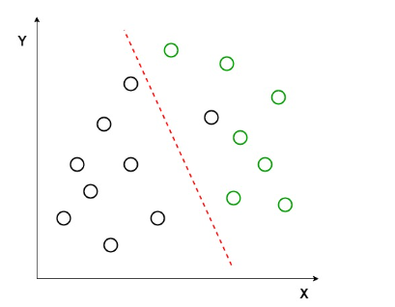
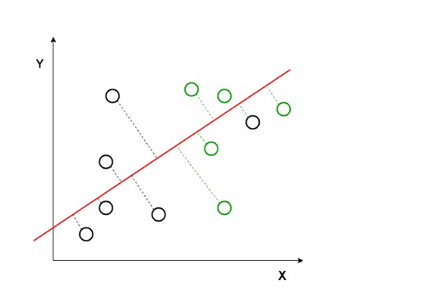
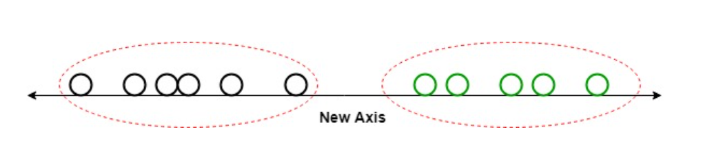
Working Of LDA
Here, Linear Discriminant Analysis uses both the axes (X and Y) to create a new axis and projects data onto a new axis in a way to maximize the separation of the two categories and hence, reducing the 2D graph into a 1D graph.
Two criteria are used by LDA to create a new axis:
Maximize the distance between means of the two classes.
Minimize the variation within each class.

Slide 69
Pros and Cons
Pros
It is a simple and computationally efficient algorithm. It can work well even when the number of features is much larger than the number of training samples. It can handle multicollinearity (correlation between features) in the data.
Cons
It assumes that the data has a Gaussian distribution, which may not always be the case. It assumes that the covariance matrices of the different classes are equal, which may not be true in some datasets. It assumes that the data is linearly separable, which may not be the case for some datasets. It may not perform well in high-dimensional feature spaces.

Slide 70
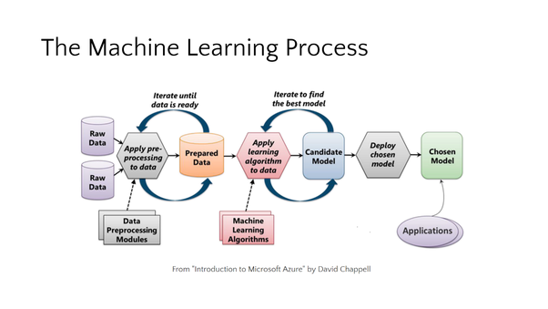
Machine Learning

Slide 71
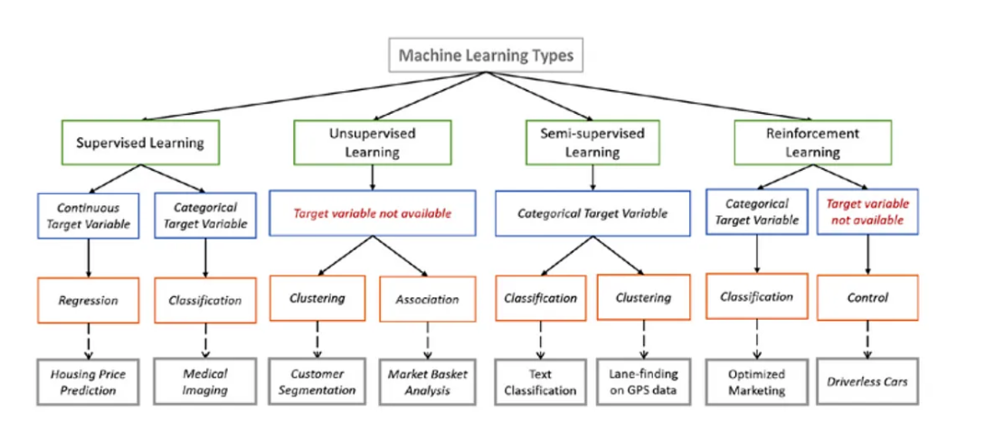
ML algorithms

Slide 72
Supervised ML Algorithms
Supervised learning algorithms try to model relationships and dependencies between the target prediction output and the input features such that we can predict the output values for new data based on those relationships which it learned from the previous data sets.

Slide 73
Supervised Algorithm
Linear Regression
Logistic Regression
Decision Tree
SVM
Naive Bayes
kNN
K-Means
Random Forest
Dimensionality Reduction Algorithms
Gradient Boosting algorithms
GBM
XGBoost
LightGBM
CatBoost

Slide 74
Linear regression
The best way to understand linear regression is to relive this experience of childhood. Let us say, you ask a child in fifth grade to arrange people in his class by increasing the order of weight, without asking them their weights! What do you think the child will do? He/she would likely look (visually analyze) at the height and build of people and arrange them using a combination of these visible parameters. This is linear regression in real life! The child has actually figured out that height and build would be correlated to weight by a relationship, which looks like the equation above.
In this equation:
Y – Dependent Variable
a – Slope
X – Independent variable
b – Intercept
These coefficients a and b are derived based on minimizing the sum of the squared difference of distance between data points and the regression line.

Slide 75
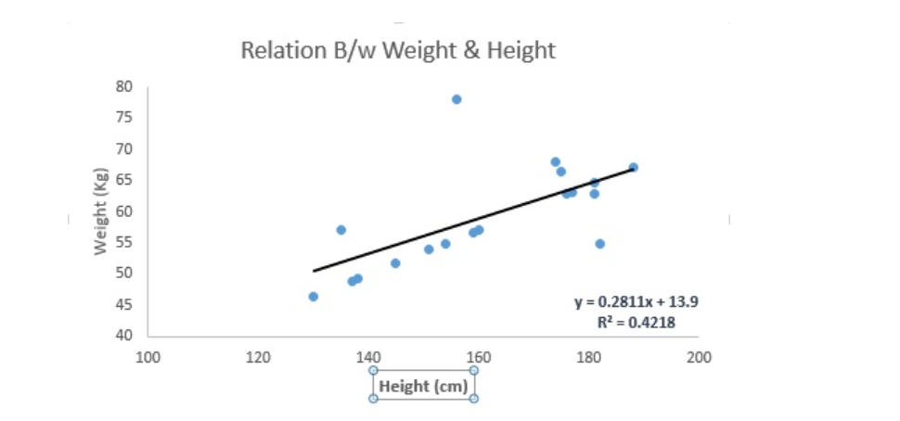

Slide 76
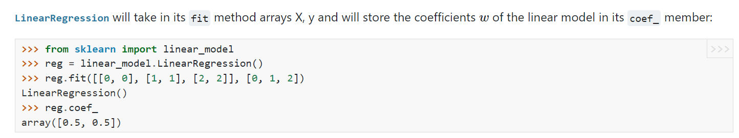
Linear Regression is mainly of two types: Simple Linear Regression and Multiple Linear Regression. Simple Linear Regression is characterized by one independent variable. And, Multiple Linear Regression(as the name suggests) is characterized by multiple (more than 1) independent variables. While finding the best fit line, you can fit a polynomial or curvilinear regression. And these are known as polynomial or curvilinear regression.

